Slide 1

Library Management System

Slide 2
About Me
Pranith Kumar Muthyapu Background: B.Tech in Information Technology, MLR Institute of Technology, Hyderabad (Batch 2026).
Why Data Analyst:
Passionate about deriving insights from raw data using SQL, Python, and visualization tools to solve real-world problems.
Tech Stack: Python, SQL,Power BI, Excel.
LinkedIn: linkedin.com/in/pranith-kumar-365987326| GitHub: github.com/PranithKumar1

Slide 3
About Me
Anwesh Bussa Background: B.Tech in Information Technology, MLR Institute of Technology, Hyderabad (Batch 2026).
Why Data Analytics:
I chose Data Analytics because I enjoy finding patterns and turning raw data into meaningful insights that drive real business decisions
Tech Stack: Python, SQL,Power BI, Excel.
LinkedIn: linkedin.com/in/anwesh-bussa | GitHub: github.com/anwesh-bussa

Slide 4
Agenda
Project Objective
Database Schema
Key Analysis Questions & Query Results
Conclusions & Key Findings
Experience & Challenges

Slide 5
Project Objective
Goal: Design, build, and query a fully normalized relational Library Database in MySQL that models real-world library operations.
Database Design: Create 7 tables - Publisher, Book, Book Authors, Library Branch, Book Copies, Borrower, and Book Loans.
Relationships: Enforce referential integrity using Primary Keys and Foreign Keys across all tables.
Data Population: 16 publishers, 20 books, 20 authors, 4 library branches, 8 borrowers, 80 book copy records, 51 loan records.
Analysis: Answer 7 business use-case queries using SQL JOINs, subqueries, GROUP BY, HAVING, and date filters.
Tools Used: MySQL Workbench for schema creation, data import, and query execution.

Slide 6
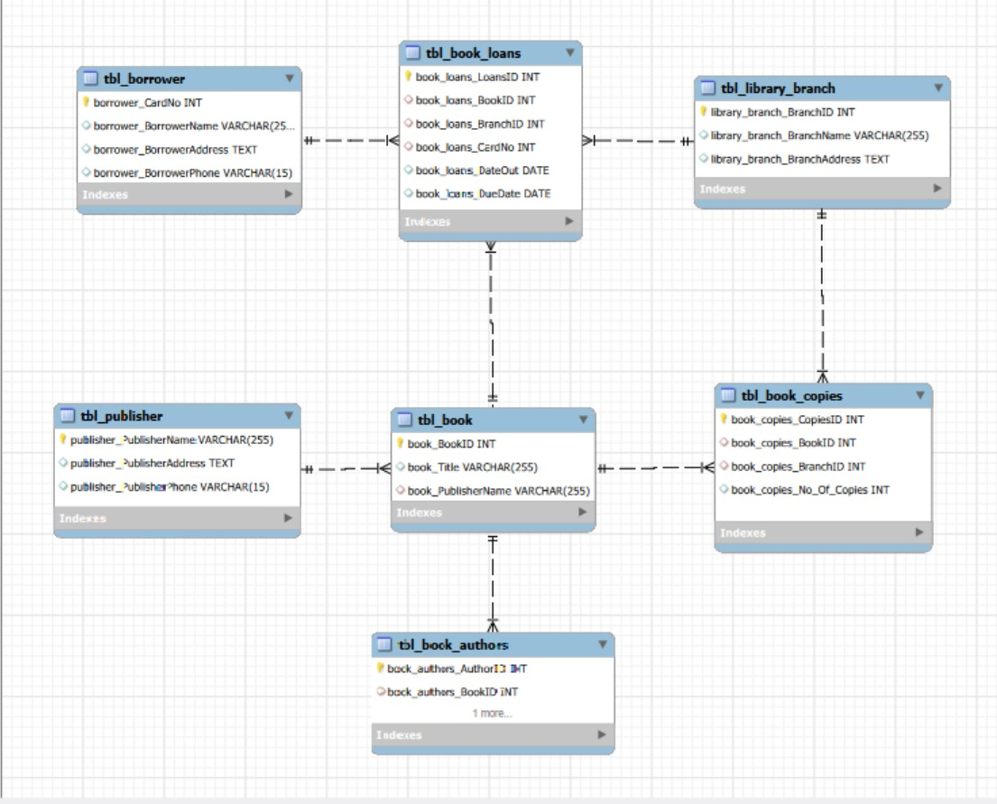
Database Schema

Slide 7
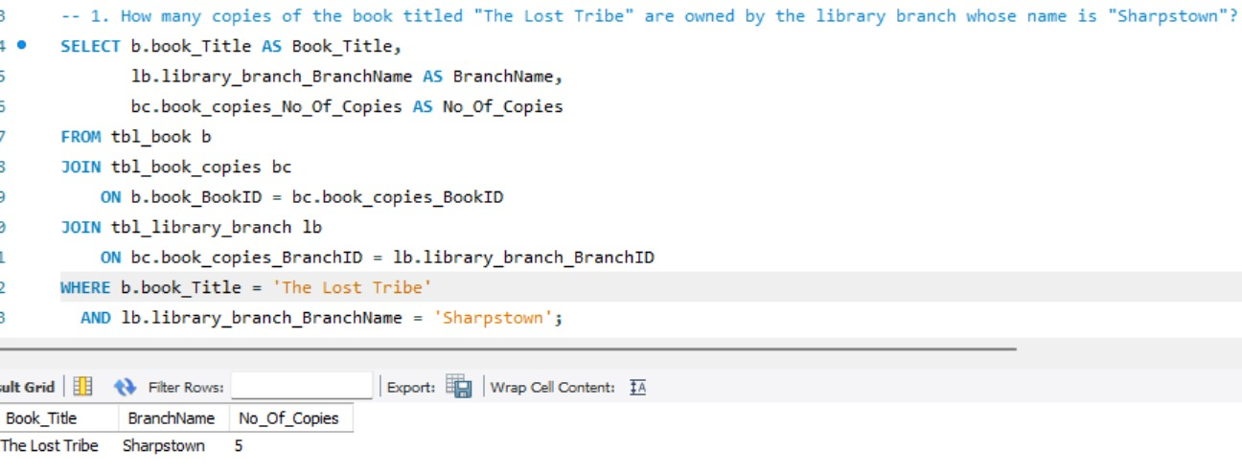
Key Analysis Questions & Query Results
Q1: How many copies of 'The Lost Tribe' are owned by the Sharpstown branch?
Approach:
Join Book, Book Copies, and Library Branch tables.
Filter by book title = “The Lost Tribe”.
Filter by branch name = “Sharpstown”.
Insights:
Sharpstown branch owns 5 copies.
Book is sufficiently available for borrowers.
Helps librarians track branch-specific inventory.

Slide 8
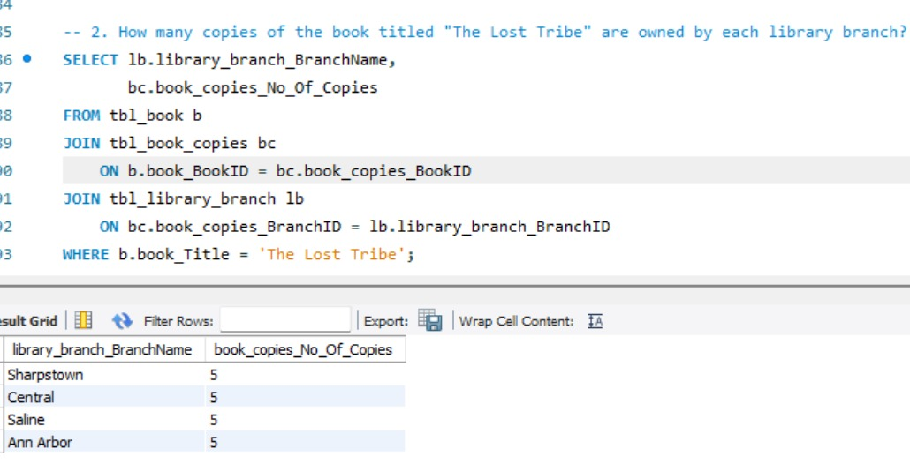
Q2:How many copies of the book titled "The Lost Tribe" are owned by each library branch?
Approach
Join Book, Book Copies, and Branch tables.
Filter only “The Lost Tribe”.
Display copies branch-wise.
Insight
Every branch has 5 copies.
Book distribution is balanced.
No branch faces a shortage of this title.

Slide 9
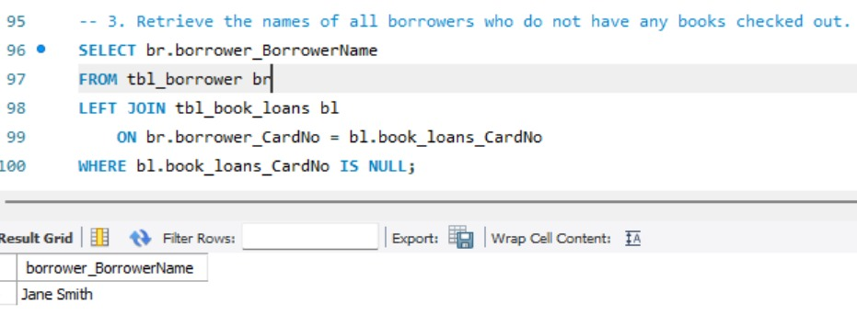
Q3:Retrieve the names of all borrowers who do not have any books checked out.
Approach
Use LEFT JOIN between Borrower and Loans.
Keep all borrowers.
Filter records with NULL loan information.
Insight
Jane Smith has not borrowed any books.
Indicates low member activity.
Library can run engagement programs for inactive users.

Slide 10
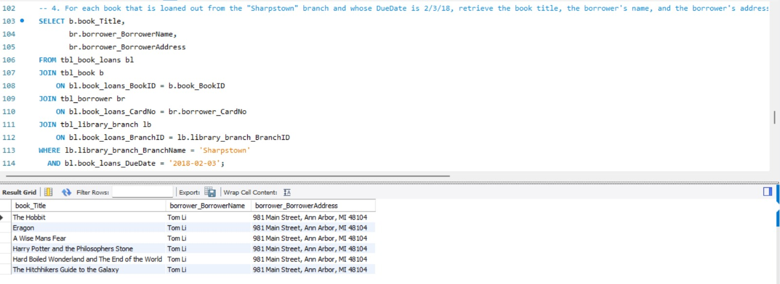
Q4:For each book that is loaned out from the "Sharpstown" branch and whose Due Date is 2/3/18, retrieve the book title, the borrower's name, and the borrower's address.
Approach
Join Loans, Books, Borrowers, and Branch tables.
Filter branch = Sharpstown.
Filter due date = 2018-02-03.
Insight
Multiple books are due on the same date.
Borrower Tom Li holds several books.
Useful for sending return reminders.

Slide 11
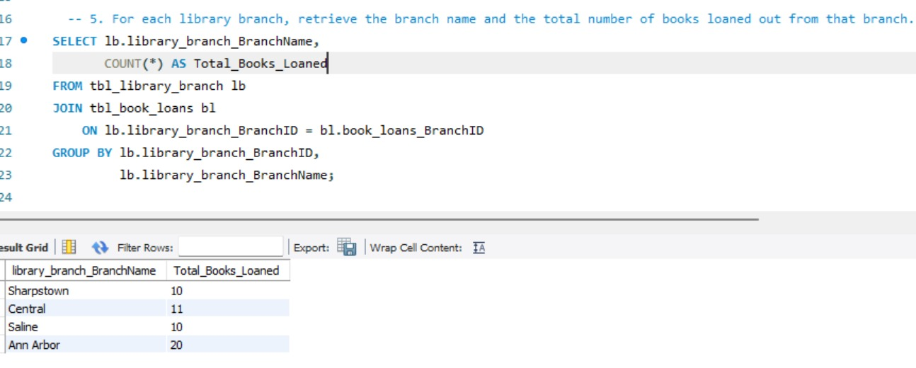
Q5:For each library branch, retrieve the branch name and the total number of books loaned out from that branch.
Approach
Join Branch and Loans tables.
Count total loans using COUNT().
Group results by branch.
Insight
Ann Arbor has the highest loans (20 books).
Central follows with 11 loans.
Indicates stronger demand at Ann Arbor branch.

Slide 12
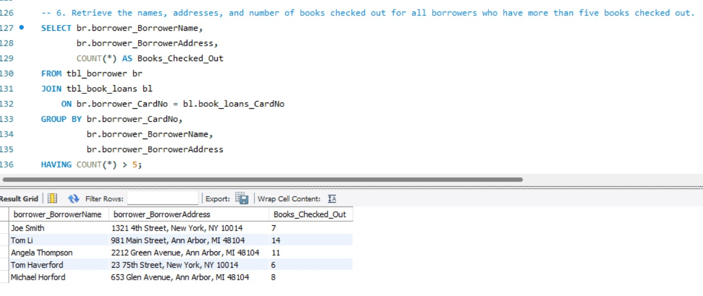
Q6:Retrieve the names, addresses, and number of books checked out for all borrowers who have more than five books checked out.
Approach
Join Borrowers and Loans tables.
Group data by borrower.
Use HAVING COUNT(*) > 5.
Insight
Tom Li borrowed the most books (14).
Some users are highly active.
Useful for loyalty programs and borrowing policy reviews.

Slide 13
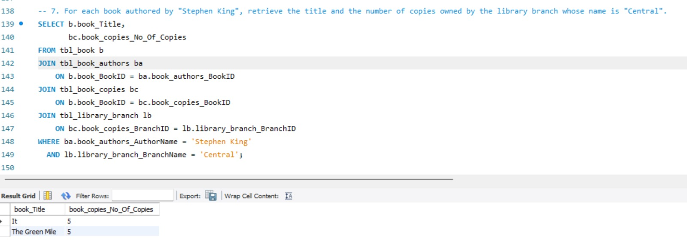
Q7:For each book authored by "Stephen King", retrieve the title and the number of copies owned by the library branch whose name is "Central".
Approach
Join Books, Authors, Copies, and Branch tables.
Filter Author = Stephen King.
Filter Branch = Central.
Insight
Central branch has 5 copies of “It”.
Central branch has 5 copies of “The Green Mile”.
Popular author titles are well stocked.

Slide 14
Conclusions & Key Findings
Balanced Book Distribution: Each library branch has the same number of book copies, keeping the inventory well organized.
Most Active Branch: The Ann Arbor branch has the highest number of book loans, showing the greatest user activity.
Active Borrowers: All borrowers have borrowed at least one book, and a few users borrowed many books, making them the most active readers.
SQL Analysis: The project used SQL queries such as JOIN, GROUP BY, HAVING, subqueries, and date filters to analyze book usage, borrower activity, and library performance.

Slide 15
Experience & Challenges
Data Cleaning: Resolved issues caused by reserved keywords and incorrect date formats during database setup.
Managed Table Dependencies: Created tables in the correct order and handled foreign key constraints to ensure successful data loading.
Built Complex Queries: Used multi-table JOINs to connect related data and generate accurate reports without duplicates.
Learned Practical SQL Skills: Gained experience in database design, data cleaning, troubleshooting errors, and writing efficient SQL queries for real-world scenarios.

Slide 16

THANK YOU

